Slide 1

Parking-Lot Occupancy Tracking
Shady Boukhary and Jesse Houk
With
Dr. Terry Griffin
Midwestern State University

Slide 2
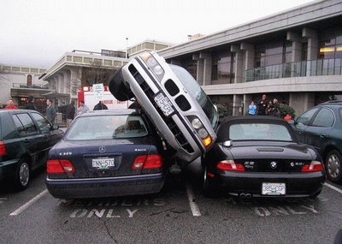
Problem
Late for class… again

Slide 3

Motivation
Elusive parking spaces
Limited availability of spaces close to classes
Expressed need by students
Not easy, but possible

Slide 4
Overview
Identifying Available Parking Spaces has 3 possible approaches
Sensors per parking space
Sensors on entrance/exit
Image processing and machine learning

Slide 5
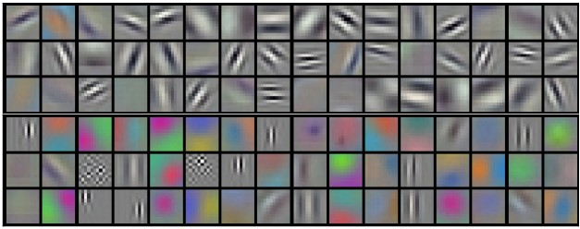
Some Terminology
Filtering
Edge Detection
Line Detection
Corner Detection
Object Detection
Color Identification
Notes:
All detections done with Canny Edge Detection with OpenCV
Filtering gives idea of using an image which also is why we use a CNN
Color ID refers to R, G, B values of a pixel of an image and associating them to determine some existance

Slide 6
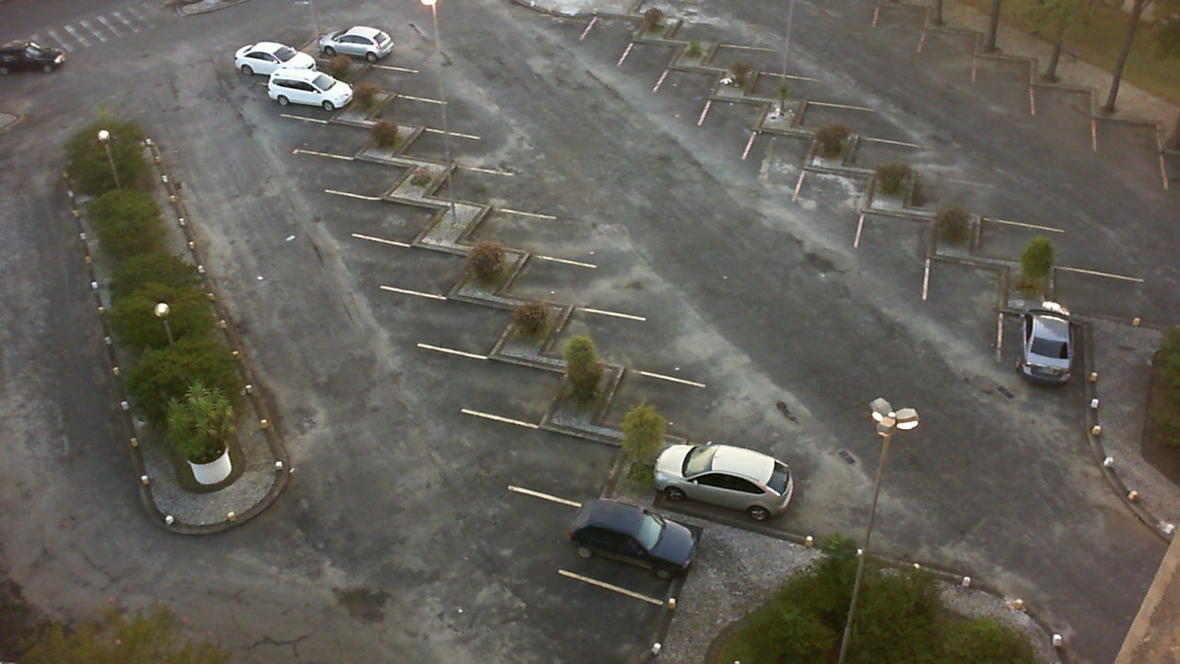
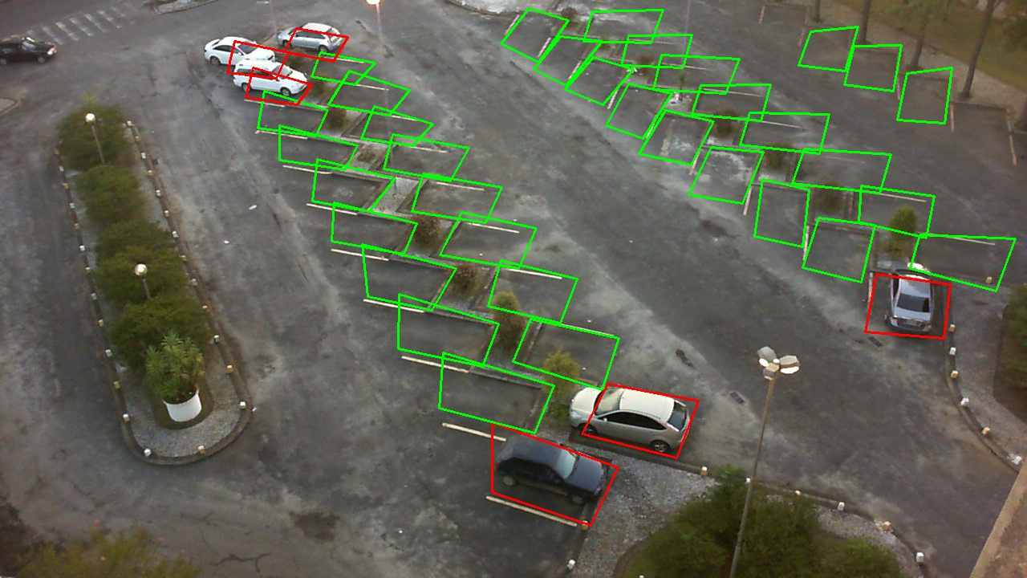








Application
( filters )
Original
Defined
Notes:
P-L-O-T/EXPERIMENT-1
Individual Spot Masking needs uniformity and organization (Current: Bottom left going up then right is 1, 2, 3, …, 40)
Edged needs rest of pictures and “ ”

Slide 7
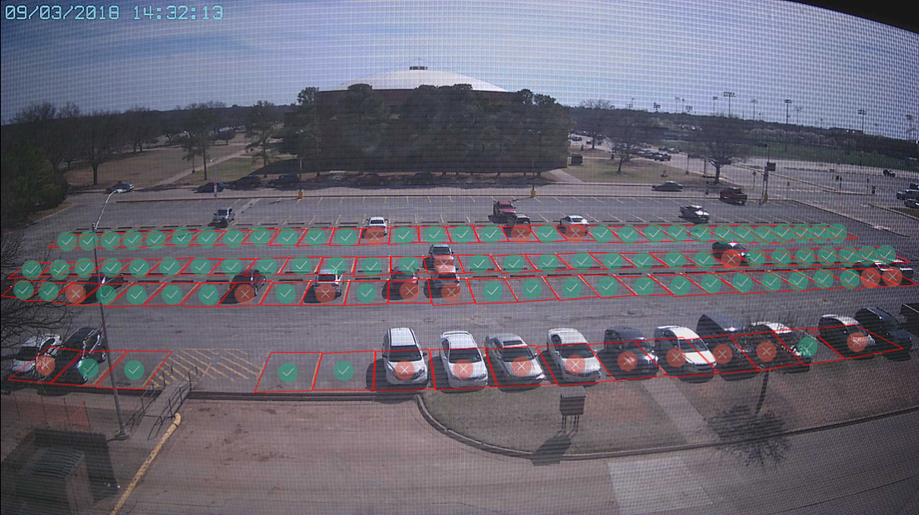
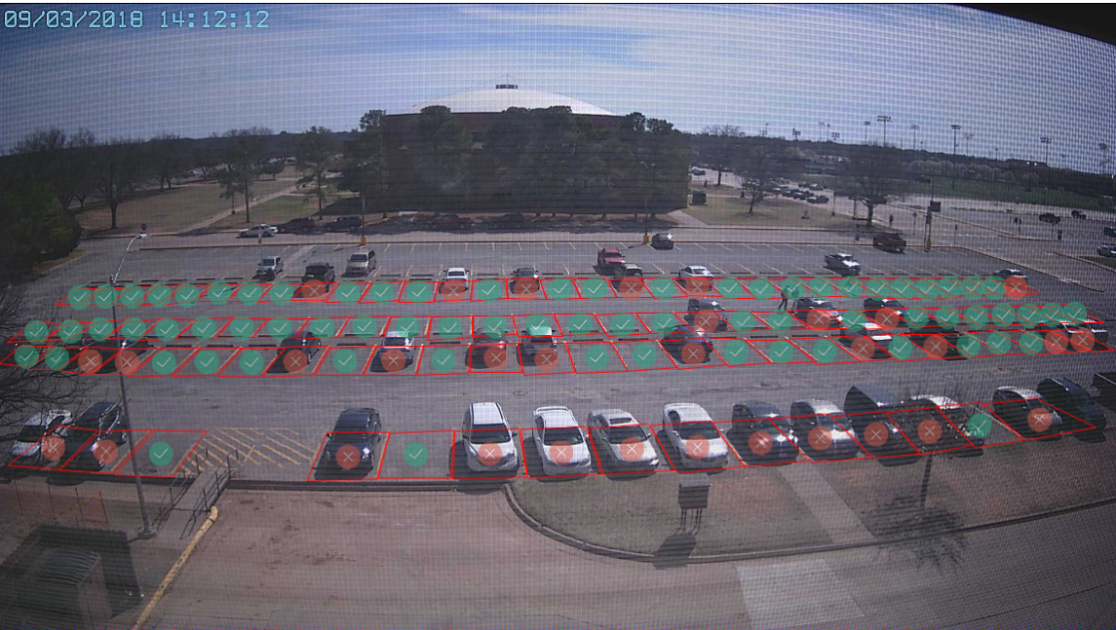
Classification
Occupied vs Available

Slide 8
{
"coord": {
"lon": -98.53,
"lat": 33.86
},
"weather": [{
"id": 804,
"main": "Clouds",
"description": "overcast clouds",
"icon": "04n"
}],
"base": "stations",
"main": {
"temp": 293.79,
"pressure": 1015,
"humidity": 60,
"temp_min": 293.15,
"temp_max": 294.15
},
"visibility": 16093,
"wind": {
"speed": 3.1,
"deg": 230
},
"clouds": {
"all": 90
},
"dt": 1518764100,
"sys": {
"type": 1,
"id": 2658,
"message": 0.0043,
"country": "US",
"sunrise": 1518787030,
"sunset": 1518826774
},
"id": 0,
"name": "Wichita Falls",
"cod": 200
}
{
"id": 31,
"occupied": 0,
"contour": {
"point": [{
"x": 1132,
"y": 581
}, {
"x": 1207,
"y": 575
}, {
"x": 1249,
"y": 620
}, {
"x": 1164,
"y": 628
}]
},
"rotatedRect": {
"center": {
"x": 1188.2656765677,
"y": 601.53300330033
},
"size": {
"w": 80,
"h": 46
},
"angle": {
"d": 46.97
}
}
}

Slide 9
Problems with classification
Color
Weather
Shadow
Motorcycles
Clouds

Slide 10

Machine learning
Progressive “learning” using statistical techniques i.e. data
Better performance over time
“Self-teaching” algorithms

Slide 11
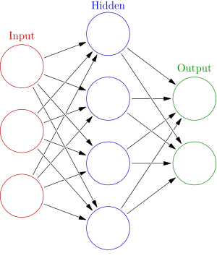
NEURAL nETWORKS
Collections of artificial neurons
Organized in layers
Learn by considering examples
Inspired by the human brain
CAT VS DOG
STREET SIGNS

Slide 12
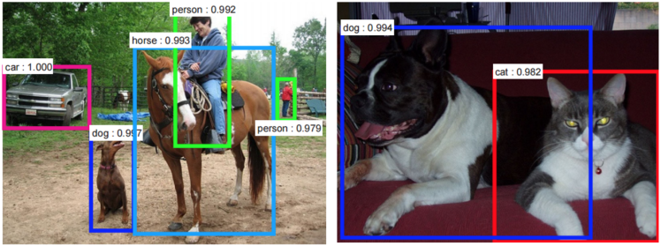
Convolutional neural networks (cnns)
Resemble an animal’s visual cortex
Used to analyze visual imagery

Slide 13
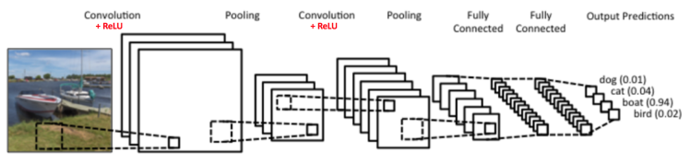
Convolutional neural networks CONT.
Input layer
Hidden layer
Convolution layers
Pooling layers
Fully-connected layers
Normalization layers
Output layer
Training set vs Testing set
Notes:
The convolution emulates the response of an individual neuron to visual stimuli
parameters consist of learnable filters which have a small receptive field
network learns filters that activate when it detects some specific type of feature at some spatial position in the input
Local or global pooling layers which combine the outputs of neuron clusters at one layer into a single neuron in the next layer
Max pooling, average pooling
average pooling, which uses the average value from each of a cluster of neurons at the prior layer
reduces amount of computation and amount of parameters. Exact location of a feature is less important than its rough location to other features
Fully connected layers connect every neuron in one layer to every neuron in another layer. It is in principle the same as the traditional multi-layer perceptron neural network
Activations computed with a matrix multiplication operation
Normalizes an 8-bit grayscale image of 50 to 180 pixel values to a larger dynamic range: contrast stretching, histogram stretching etc
Training Set: this data set is used to adjust the weights on the neural network.
Testing Set: this data set is used only for testing the final solution in order to confirm the actual predictive power of the network.

Slide 14
Dogs vs cats

Slide 15
Mobile application
Cross-platform app
Real-time parking lot availability
Scheduled checks for availability
Built with Ionic 3 and Cordova

Slide 16
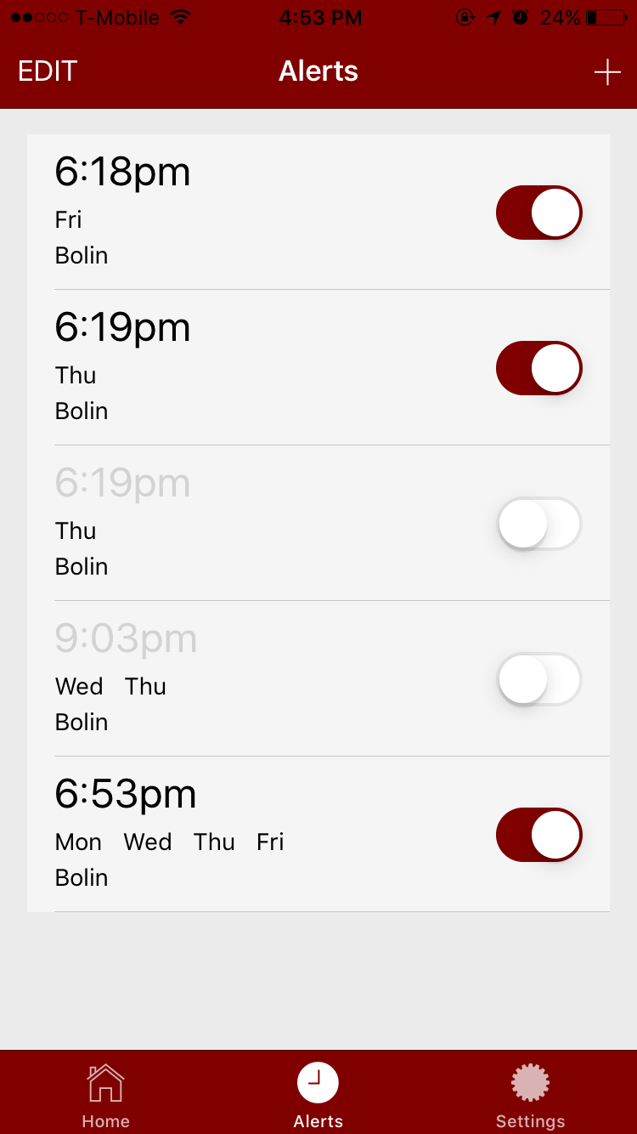
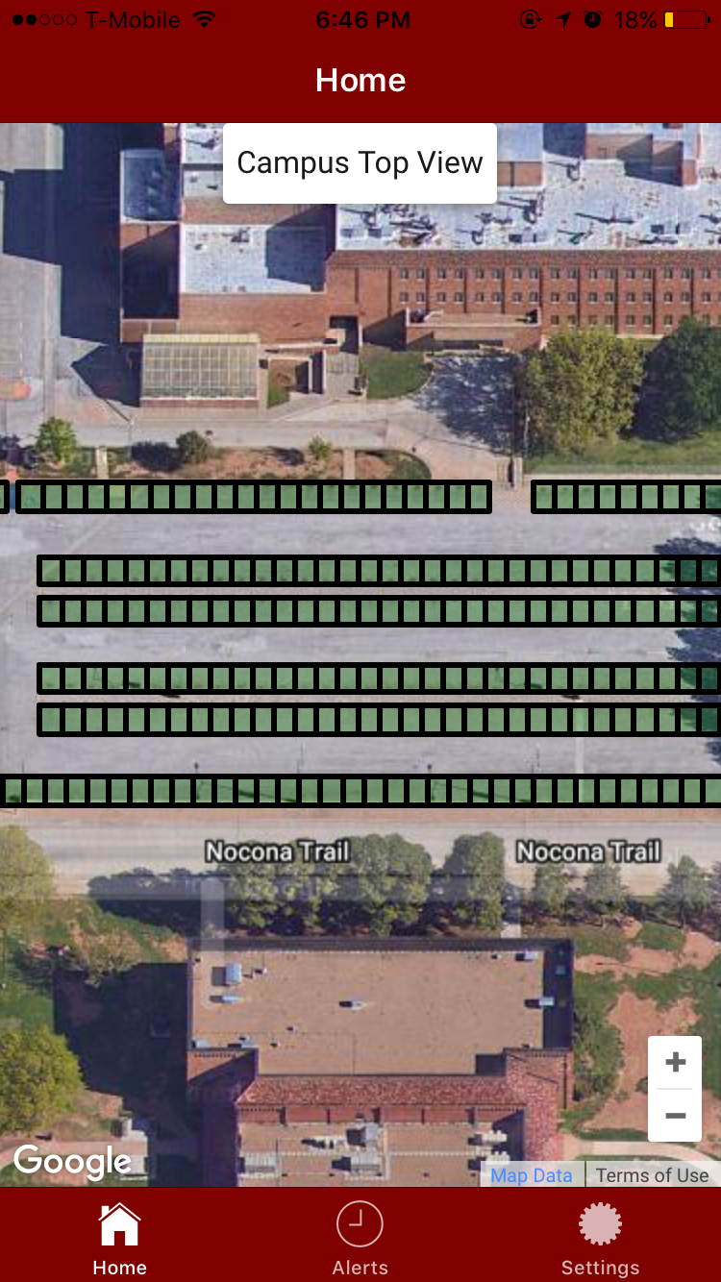
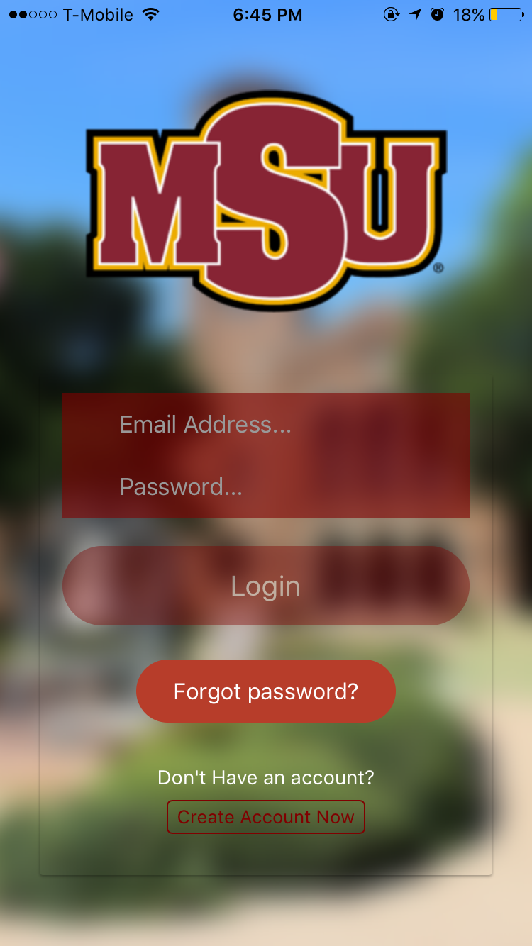
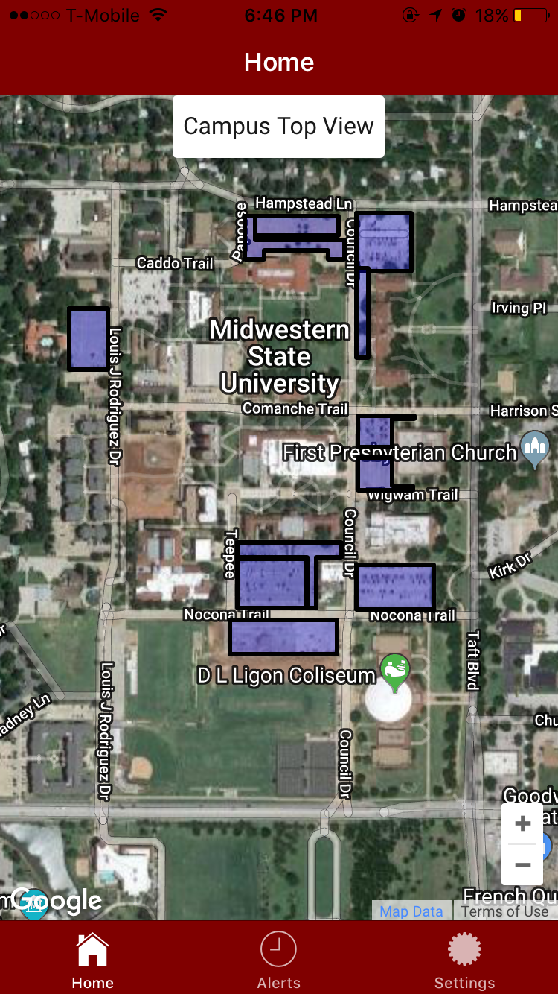
Mobile application CONT.
Google Maps overlays
Interactive map
Colors determine availability
Separate views for faculty and students

Slide 17
Future work
Continue classification phase
1
Train and Test CNN
2
Connect to the mobile app
3
Cover more parking lots
4

Slide 18
References

